Slide 1
Translation Continued
Translation using coordinates
Year 7
Mrs F
ALLPPT.com _ Free PowerPoint Templates, Diagrams and Charts

Slide 2
Opener

Slide 3
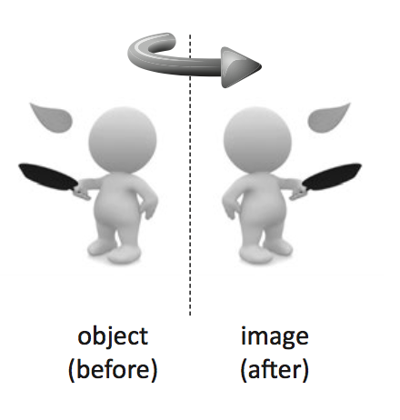
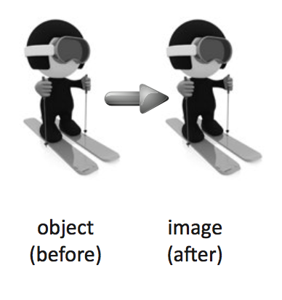
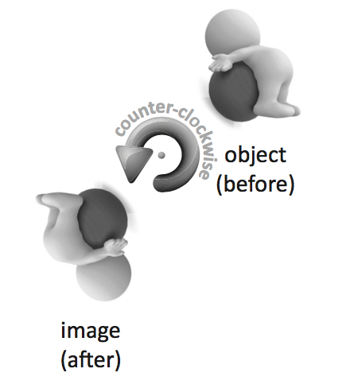
Transformation
EQ – How can we draw and describe Transformations?
What is a
Transformation?
A Transformation is the re-positioning of a shape without
changing any of it’s dimensions. :
There are three main types of Transformations
Reflections - often called a Flip
Translations - often called a Slide
Rotations - often called a Turn

Slide 4
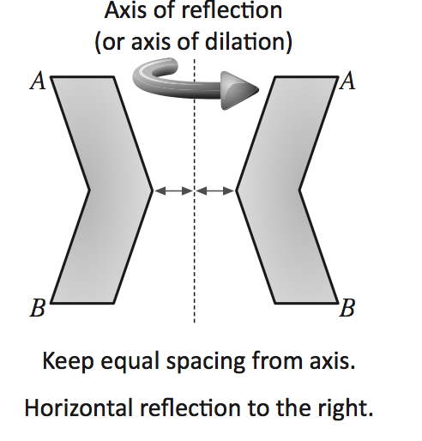
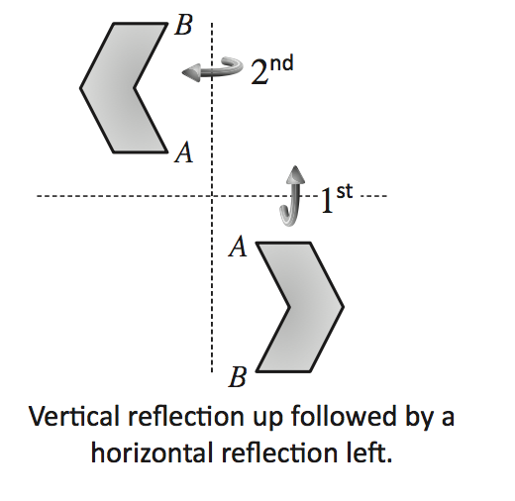
Transformation
EQ – How can we draw and describe Transformations?
What is a
Reflection?
Reflections is the Flip of an object or shape.
Reflecting an object about a fixed line called the axis of
reflection.

Slide 5
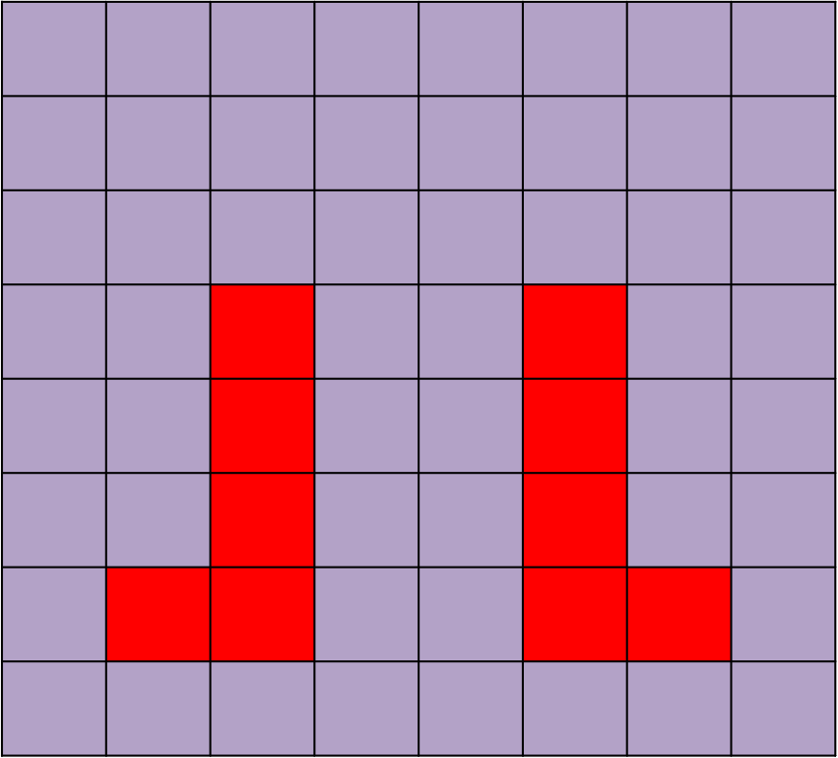
Transformation
EQ – How can we draw and describe Transformations?
What is a
Reflection?
When reflecting images in a mirror line, each point must be
the same distance away from the mirror line on each side
Points are reflect at right angles to the mirror line

Slide 6
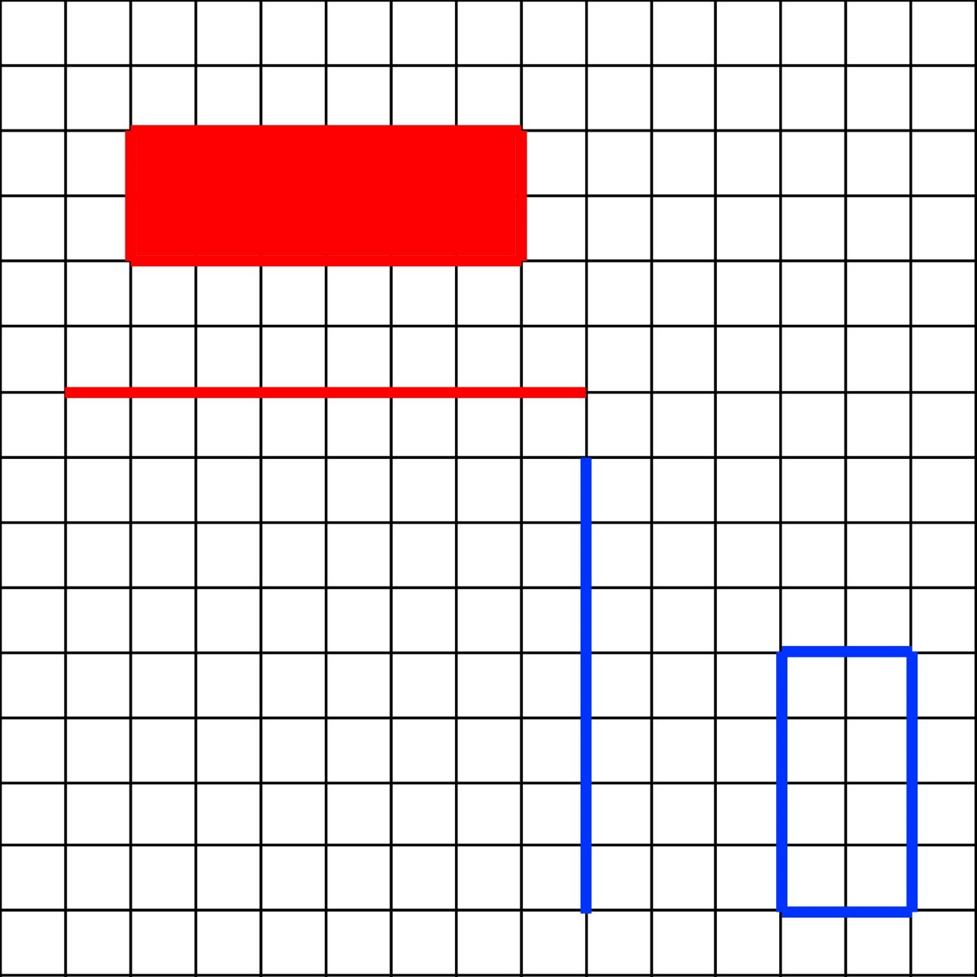
What letter would you get if you reflected each shape in its corresponding mirror line?

Slide 7
What letter would you get if you reflected each shape in its corresponding mirror line?

Slide 8
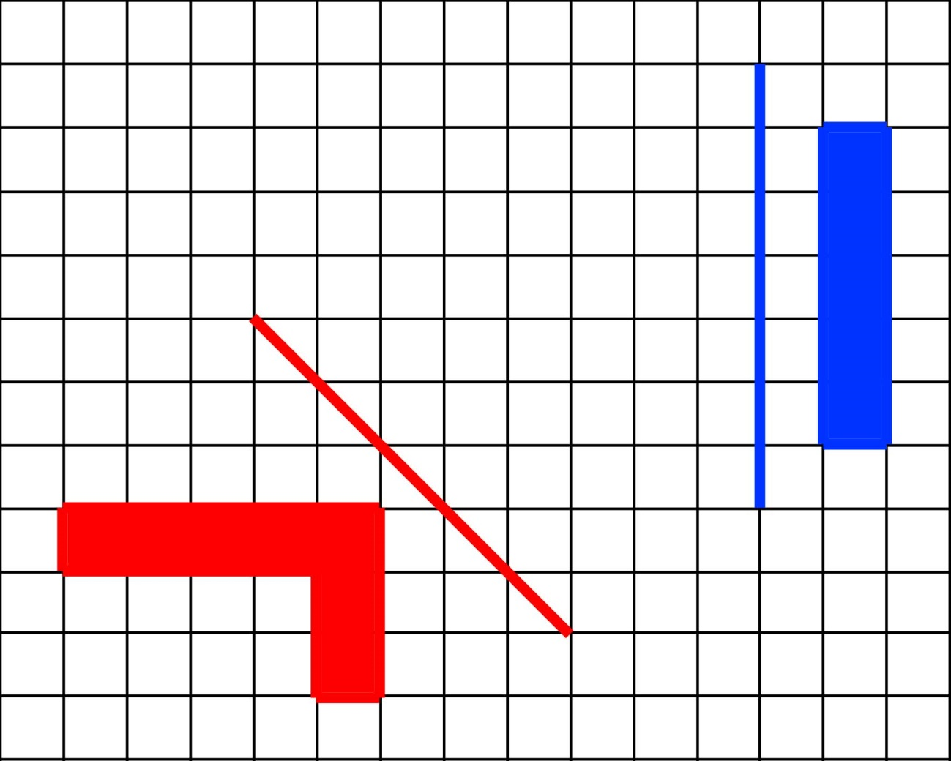
What letter would you get if you reflected each shape in its corresponding mirror line?

Slide 9
What letter would you get if you reflected each shape in its corresponding mirror line?

Slide 10
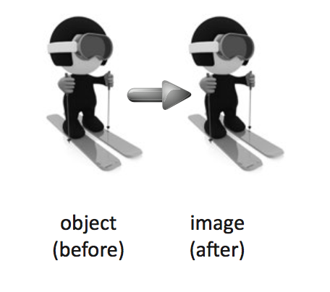
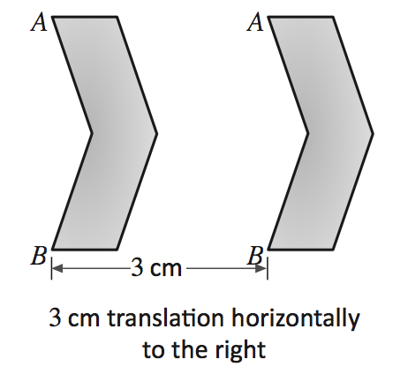
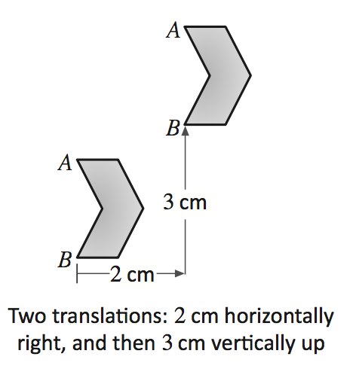
Transformation
EQ – How can we draw and describe Transformations?
What is a
Translation?
Translations is the Slide of an object or a shape.
This transformation involves sliding an object either
horizontally, vertically or both.
Every part of the object is moved the same distance.

Slide 11
Transformation
EQ – How can we draw and describe Transformations?
What is a
Translation?
A translation is a SLIDE transformation, where every point is moved the each same distance either left, right, up or down.
A translation right 3cm.
Every point on the triangle needs to move exactly 3 cm to the right

Slide 12
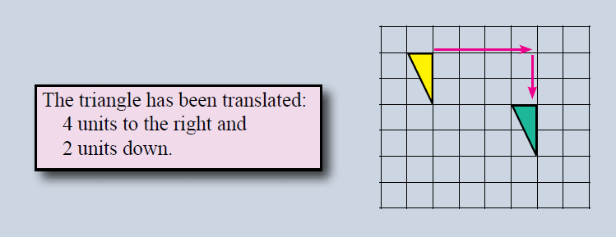
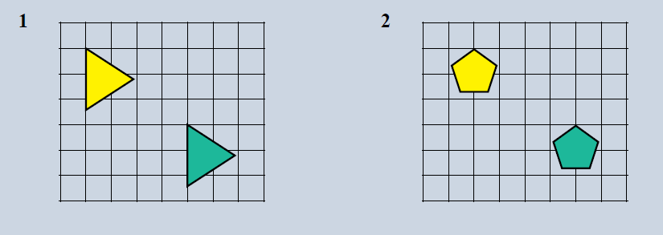
Describing a translation
You Try

Slide 13
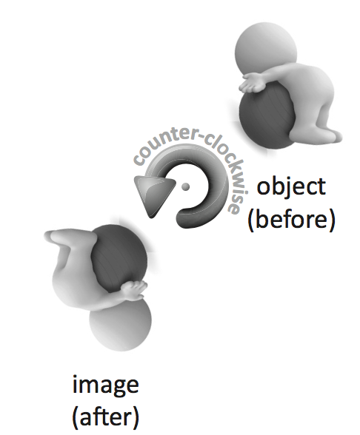
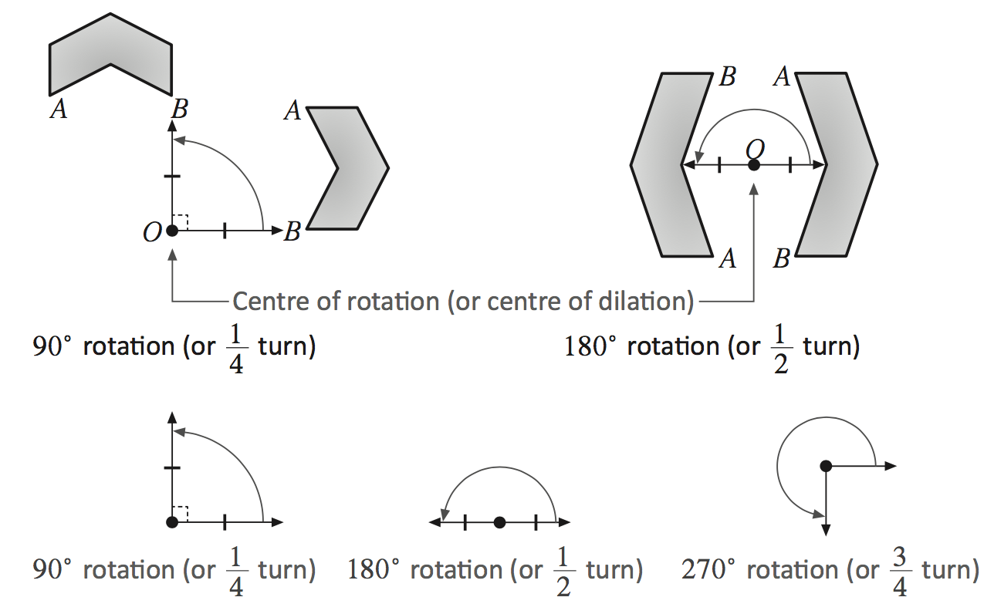
Transformation
EQ – How can we draw and describe Transformations?
What is a
Rotation?
Rotations is the turn of an object or a shape
A transformation of turning an object about a fixed point either
clockwise or anti clockwise.
It is when a shape is rotated without reflecting, translating
or changing it’s size

Slide 14
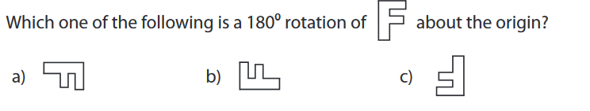
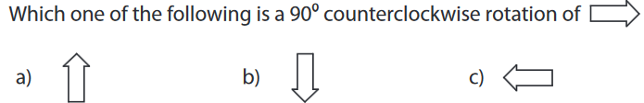
Try These

Slide 15
Your turn
My Transformation Booklet

